Slide 1
Introduction to Spatial analysis with R
Welcome!
If you have not done yet, please download all data from github:
https://github.com/Doi90/EE_Intro_Spatial_Workshop
Install R packages:
Rgdal, raster, sf, tidyverse, rgeos, maps
Schedule
10:00 -10:30 Intro
10:30 -11:30 Vector data (with 2 challenges)
11:30– 12:30 Raster data (with 2 challenges) 12:30 -1:00 LUNCH break
1:00 - 2:00 Analysis (with 2 challenges)
2:00 - 2:20 Base plot
2:20 - 2:40 ggplot
2:40 - 3:00 Final challenge

Slide 2



Intro to spatial analysis
Why us? (hi from jutta, roozbeh, david)
Why is this cool?
Types of analysis and output you can create
What to expect?
This is an supershort INTRO – hopefully gets you started on your own GIS journey

Slide 3
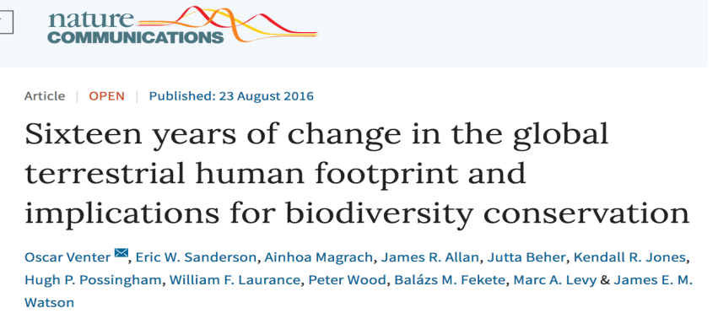
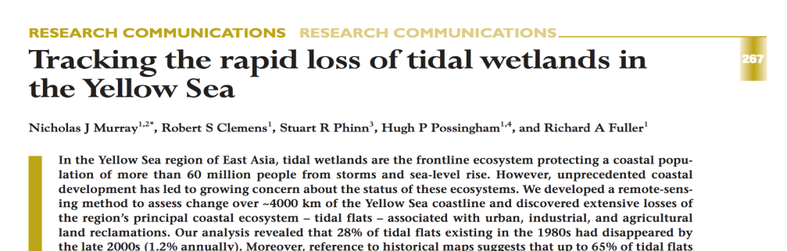
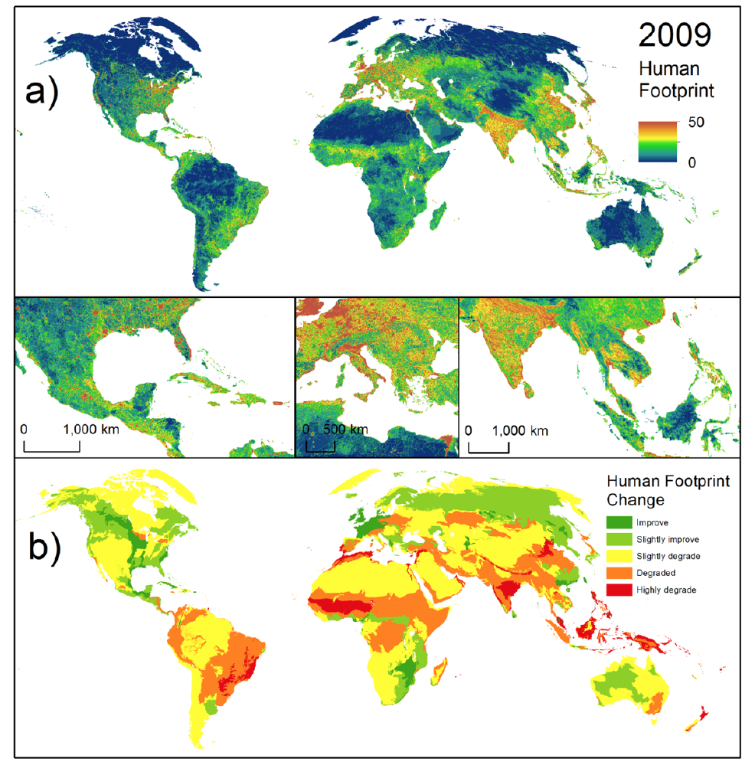
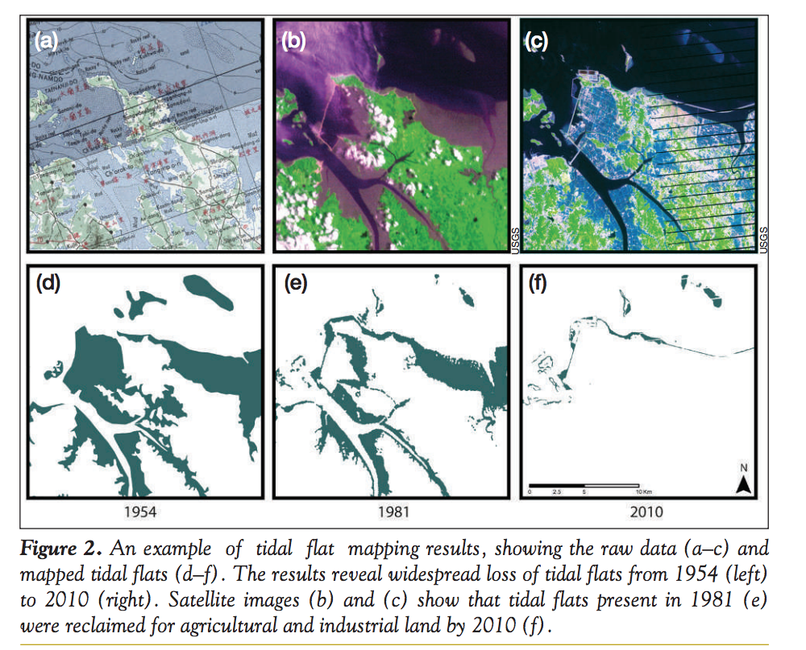
Observation: e.g. habitat loss
Notes:
Venter et al 2016, Murray et al 2014

Slide 4

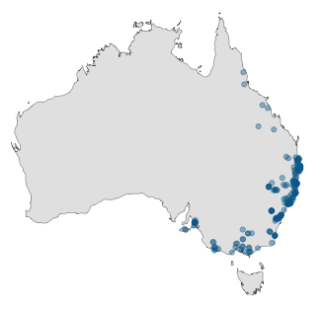
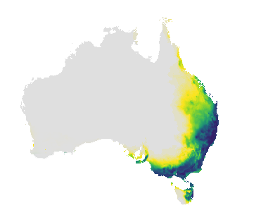

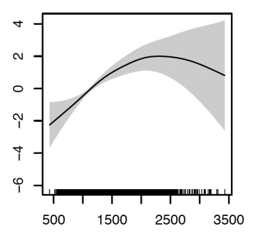
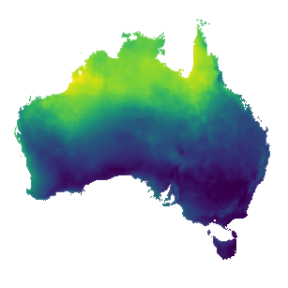
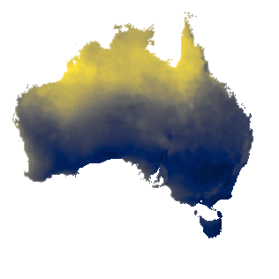
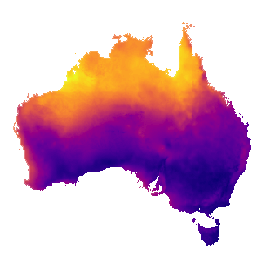
Prediction: Species Distribution modeling
Species occurrence data
Predicted probability of occurrence
Statistical or ML model
Vegetation
Rainfall
Temperature
Environmental rasters

Slide 5
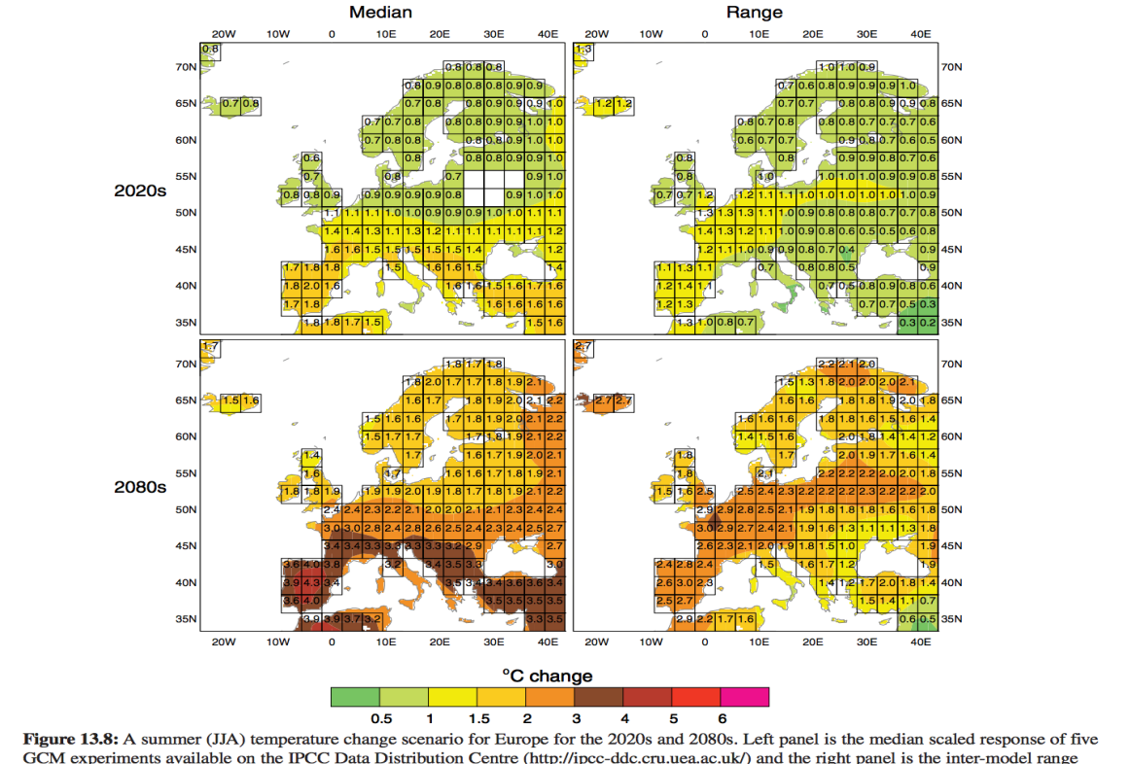
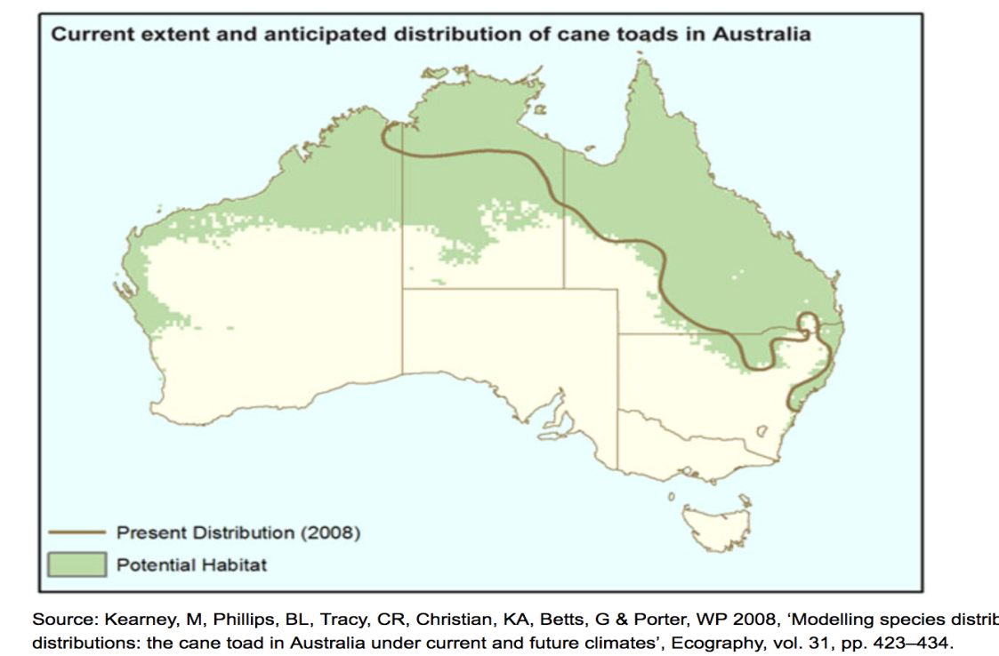
Prediction: SDM & climate

Slide 6
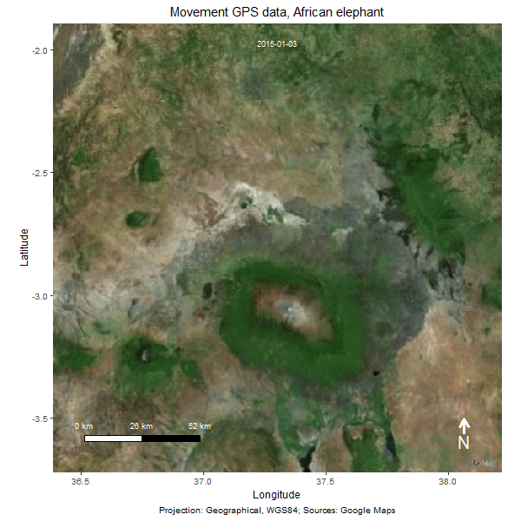
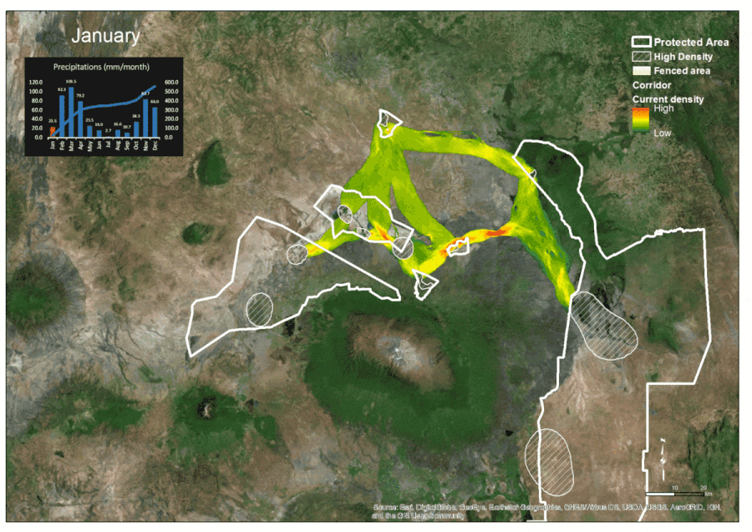
Tracking
Using GPS track data to monitor wildlife
Predicted movement corridors
Osipova, et al., (2018) Using step-selection functions to model landscape connectivity for African elephants: accounting for variability across individuals and seasons. Animal Conservation.

Slide 7
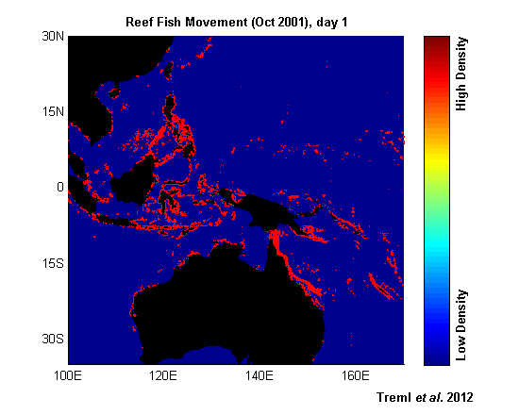

Notes:
https://mseaclab.com/research/

Slide 8
Animated data
Notes:
https://youtu.be/nUKh0fr1Od8, check out: movebank

Slide 9
What is the underlying “spatial analysis”:
What is close by? What is the consequence?
Distance & area calculations
extractions from surfaces
Interaction between layers
Layer 1
map
data
Layer 2
Computer
R
Layer 3
forest | 100 ha
urban | 1000 ha
Spatial data storage
Data preparation & analysis
Produce map or table as output
Notes:
Just to give an idea of the steps: usually data has to be prepared to be ready for analysis, and this is what half of the course is about. In most cases, this is what you will spend most time on: getting the data in a form that is ready for analysis: cleaning up, checking for inconsistencies and obvious errors, NAs, alignments, projections etc

Slide 10
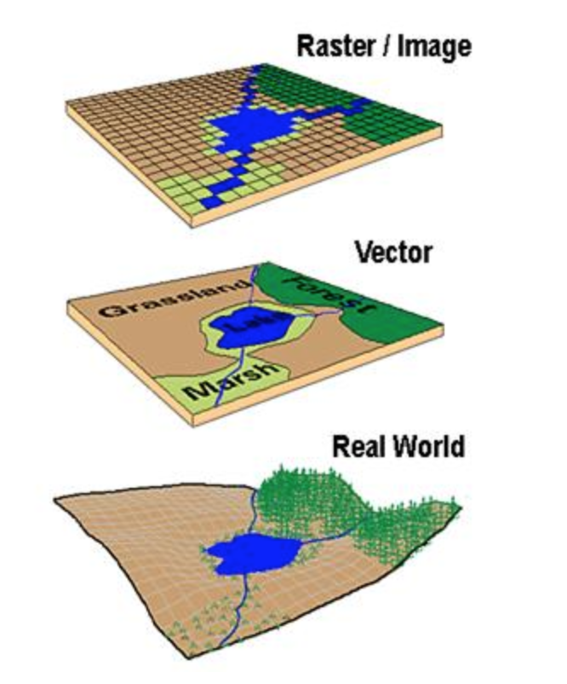
Most important concept: how to not mess my analysis up
Working with spatial data is like making a
sandwich: if the condiment is not put ON the
bread-roll, you make a mess!
Position: Sandwiches are stacks of flat (2D)
planes, but the world is round…
→ Projections of the world
Border-mismatch between data layers
→ Resolution
Notes:
Position is the broader position of the dataset in comparison to the real world (projection)
Border mismatch has something to do with the resolution of each dataset in comparison to each other and the real world (resolution that matches the analysis)

Slide 11
This is what you learn today
Basic concepts:
Projections, types of data
Reading & Manipulating data
Creating new data, creating new info
Interaction of data
Extraction, clipping, combination
Plotting
Base plot and ggplot

Slide 12
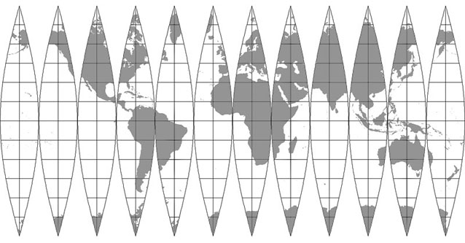
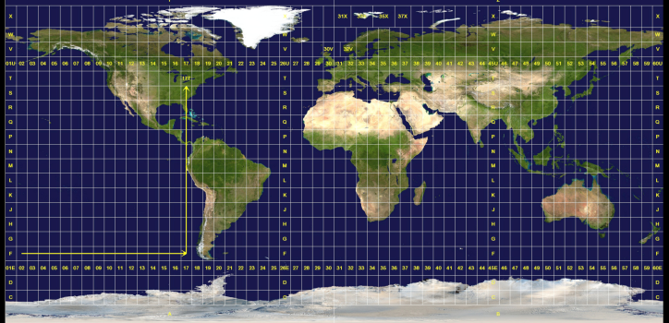
Earth = Orange peel
360
-180 0 180
https://www.jasondavies.com/maps/transition/
Notes:
Thought to show some online little video here that shows how the earth peels open to become a mercator map, and the cool transition video from Roozbeh to give them an idea how different the world can be mapped
https://www.arcgis.com/apps/MapJournal/index.html?appid=31484c80dba54a058369dfb8e9ced549

Slide 13
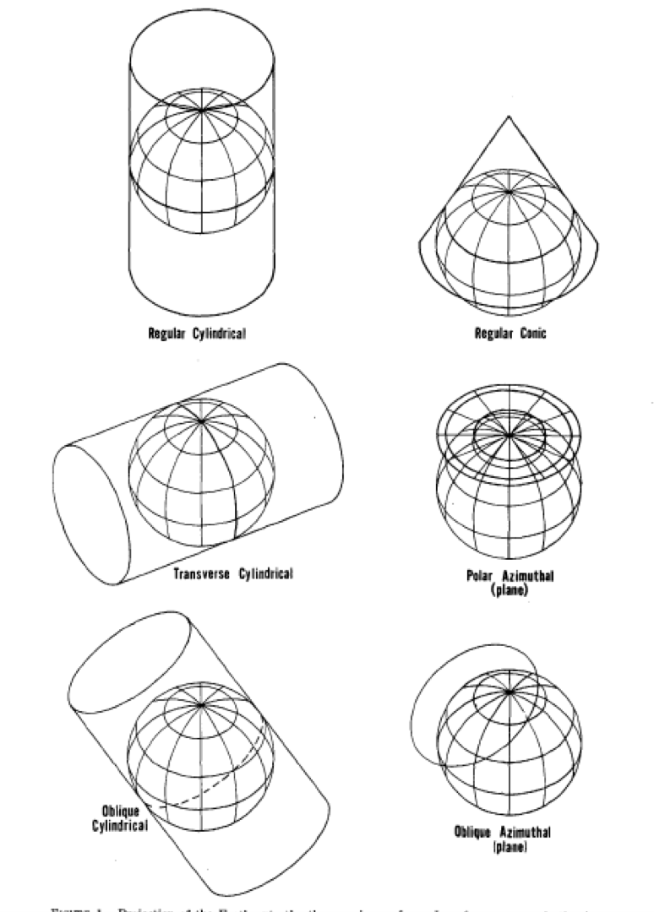
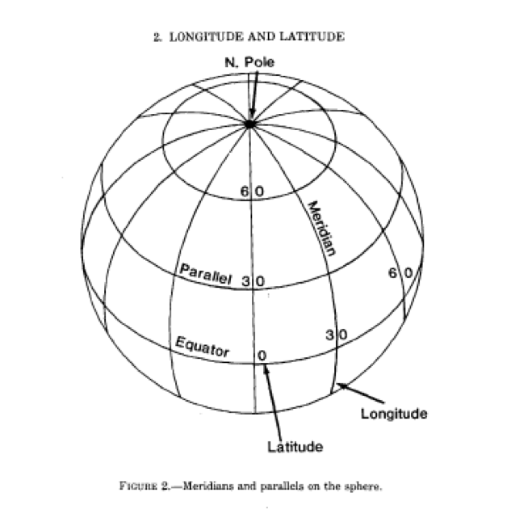
Techniques to create a 2D map from a round-ish object
Regular cylindrical
Regular conic
Transverse cylindrical
Polar Azimuthal
Longitude
Latitude
Oblique Cylindrical
Oblique Azimuthal
Notes:
Basic idea of how the different maps get made, and what lat/long means, check out: US Geological survey: John P Snyder: Map Projections: A working manual, 1987

Slide 14
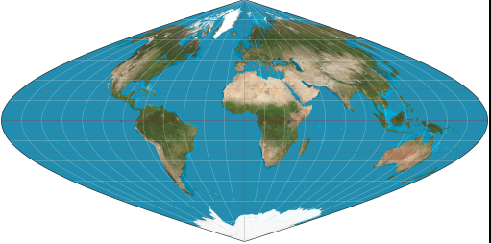
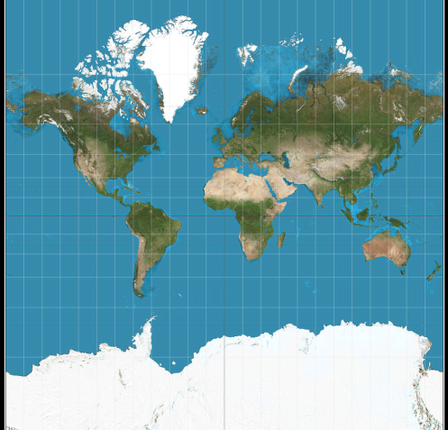
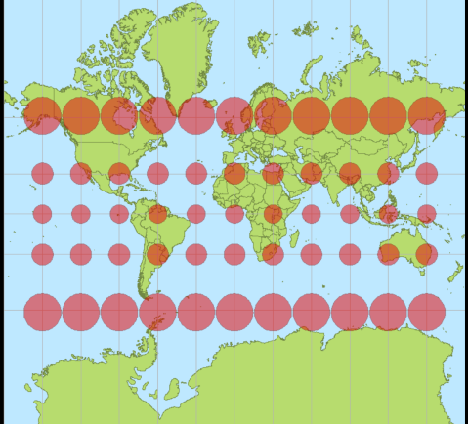
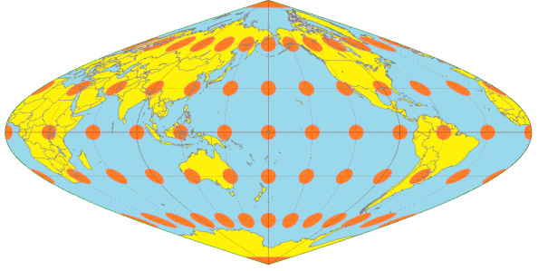
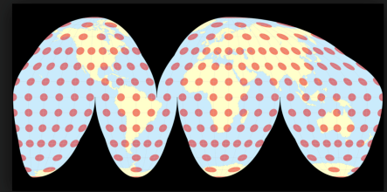
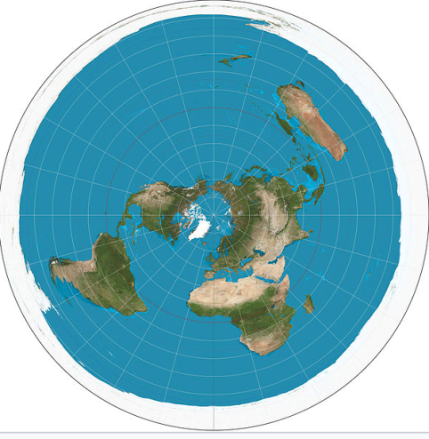
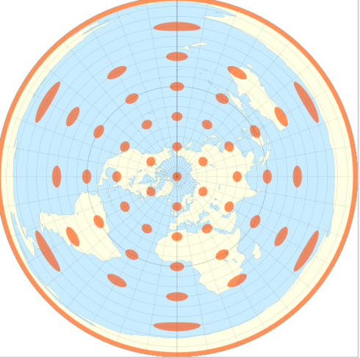
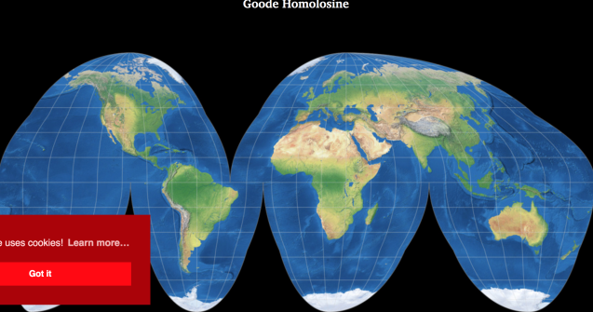
Angle, distance, area, direction
True angle (conformal)
True distance
True direction (azimuthal)
True area
Notes:
The 4 types of maps and what distortions mean: there is no projection that gives you all 4, you have to choose what you are willing to distort

Slide 15
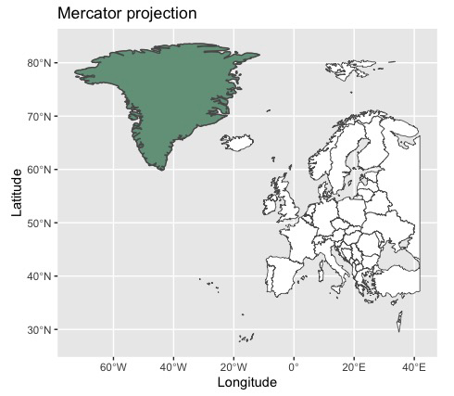
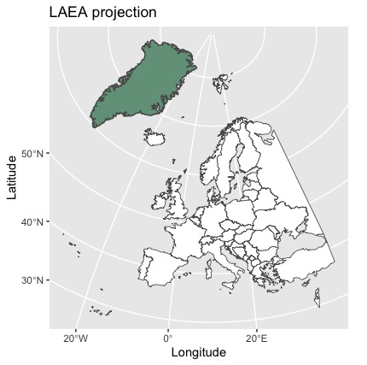
Projection
Mercator projection distorts the size of objects (area) as the latitude increases from the Equator to the poles.

Slide 16
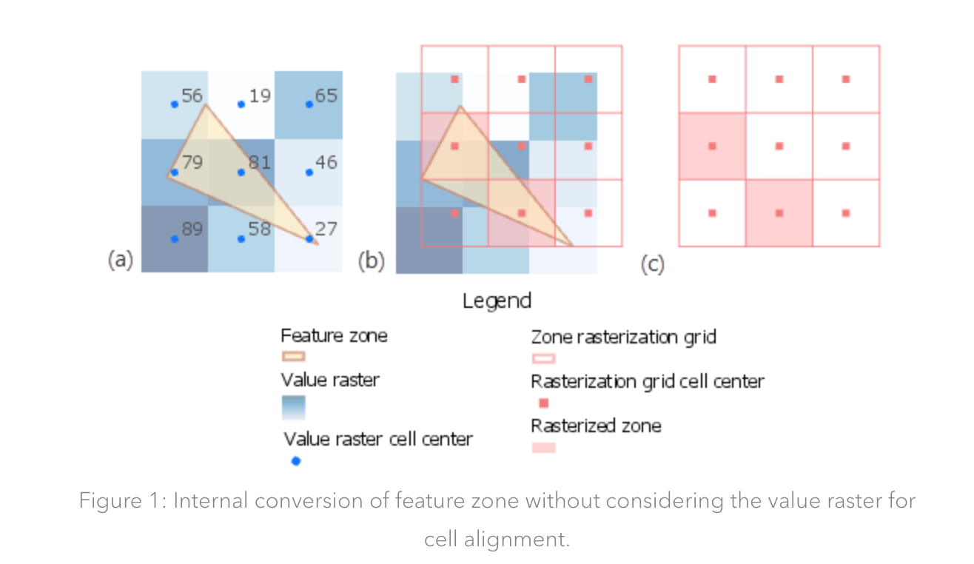
Overlay details matter!
Notes:
From https://www.esri.com/arcgis-blog/products/spatial-analyst/analytics/getting-the-most-out-of-zonal-statistics/
To talk about resolution match and why sometimes zooming in helps to understand if the data is good enough for the analysis that you want to do

Slide 17
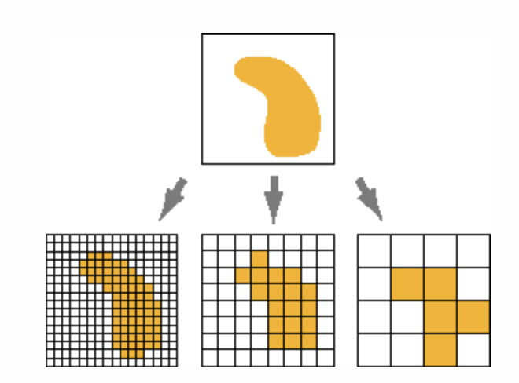
Data types & resolution: Raster
Resolution = size of cells
# rows
# columns
Tradeoff:
Accuracy
File size
Computing time
Notes:
Info about raster

Slide 18

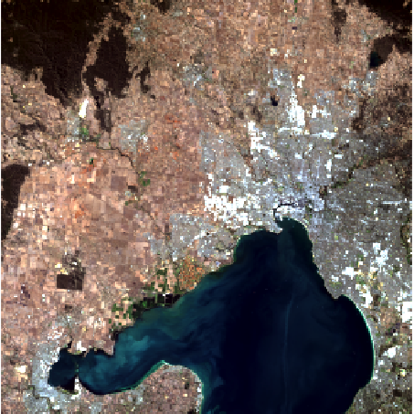
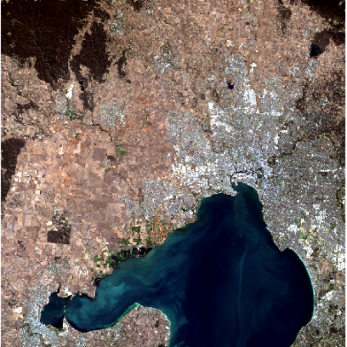
Spatial scale
Extent: Is data available across occurrence locations & landscape we want to predict to?
Grain/resolution: cell size, smallest unit. Does this match what we want to model (species) & our application?
Resolution
3000 x 3000 m
300x 300 m
30 x 30 m

Slide 19
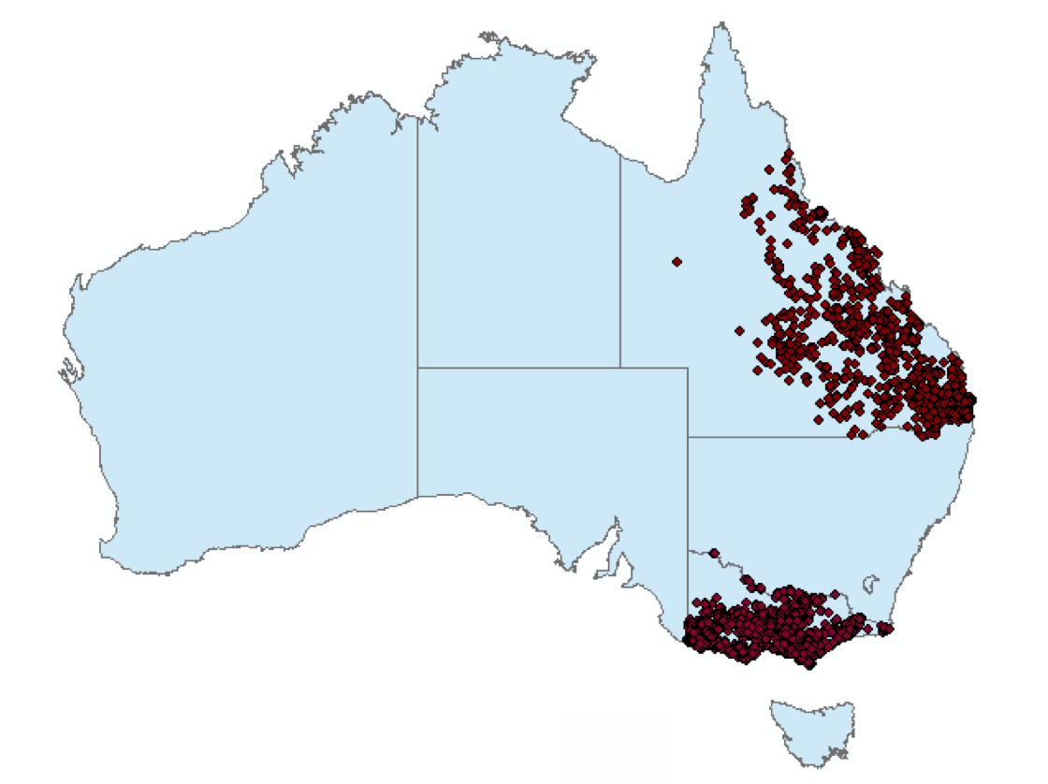
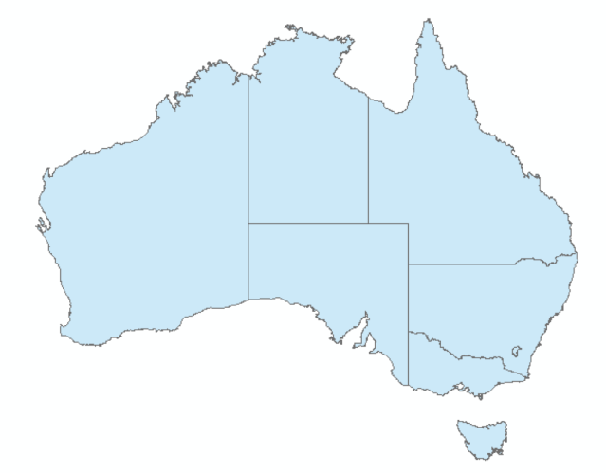
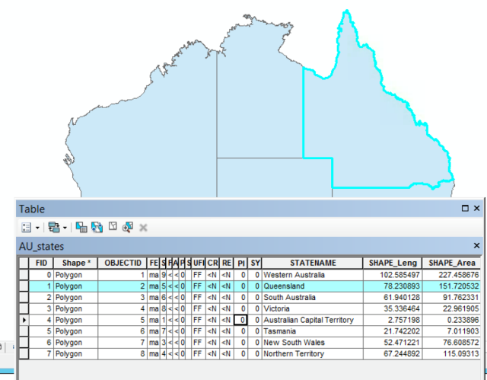
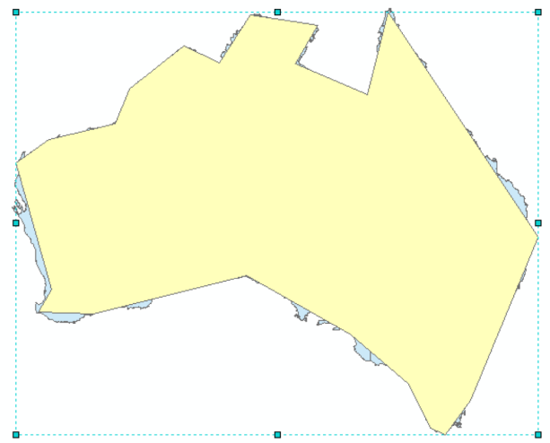
Data types & resolution: Vector
Tradeoff:
Accuracy
File size
Computing time
Notes:
Info about vector (points are the koala data from ALA)

Slide 20
Keep in mind:
Know your data! (and its limitation)
The question is as important as the data!
Explore / zoom / test if possible (check out QGIS, or the map-edit package Roozbeh showed at the end)
Pay attention to projections!
Notes:
summary

Slide 21
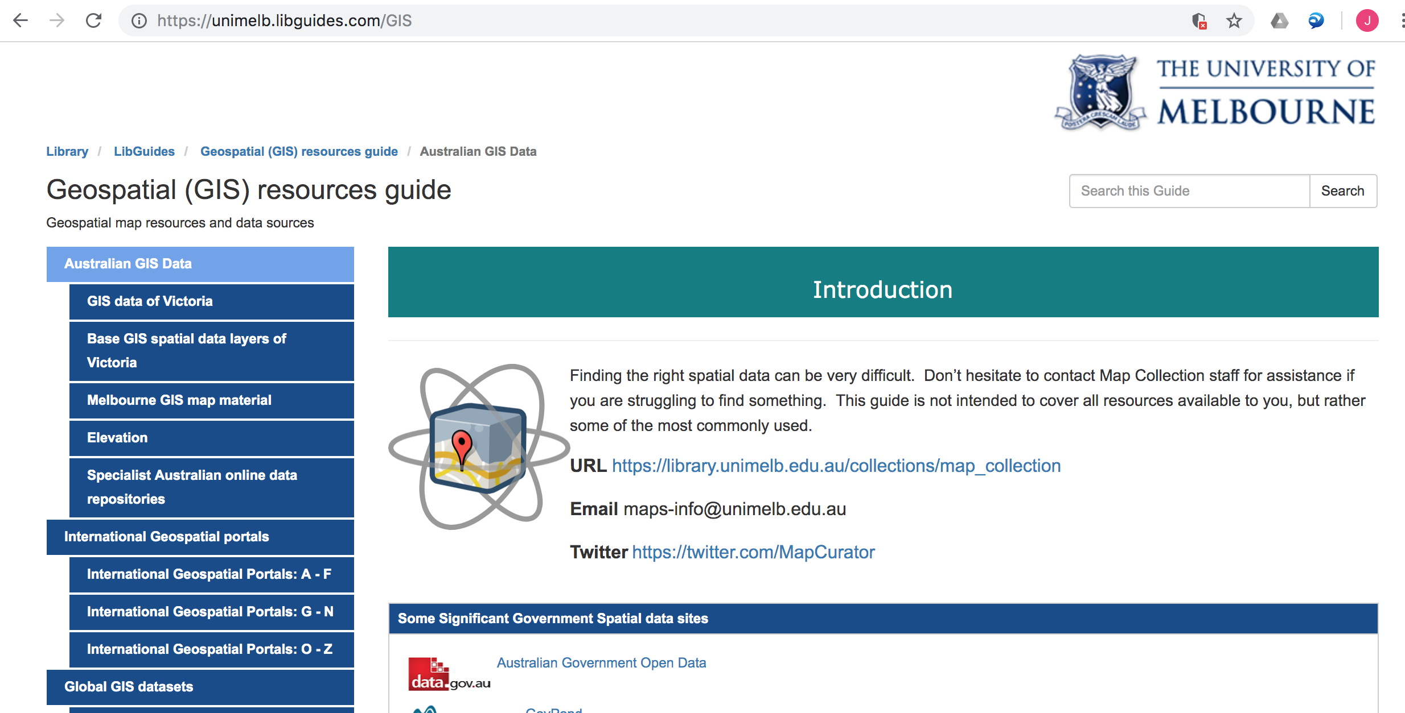
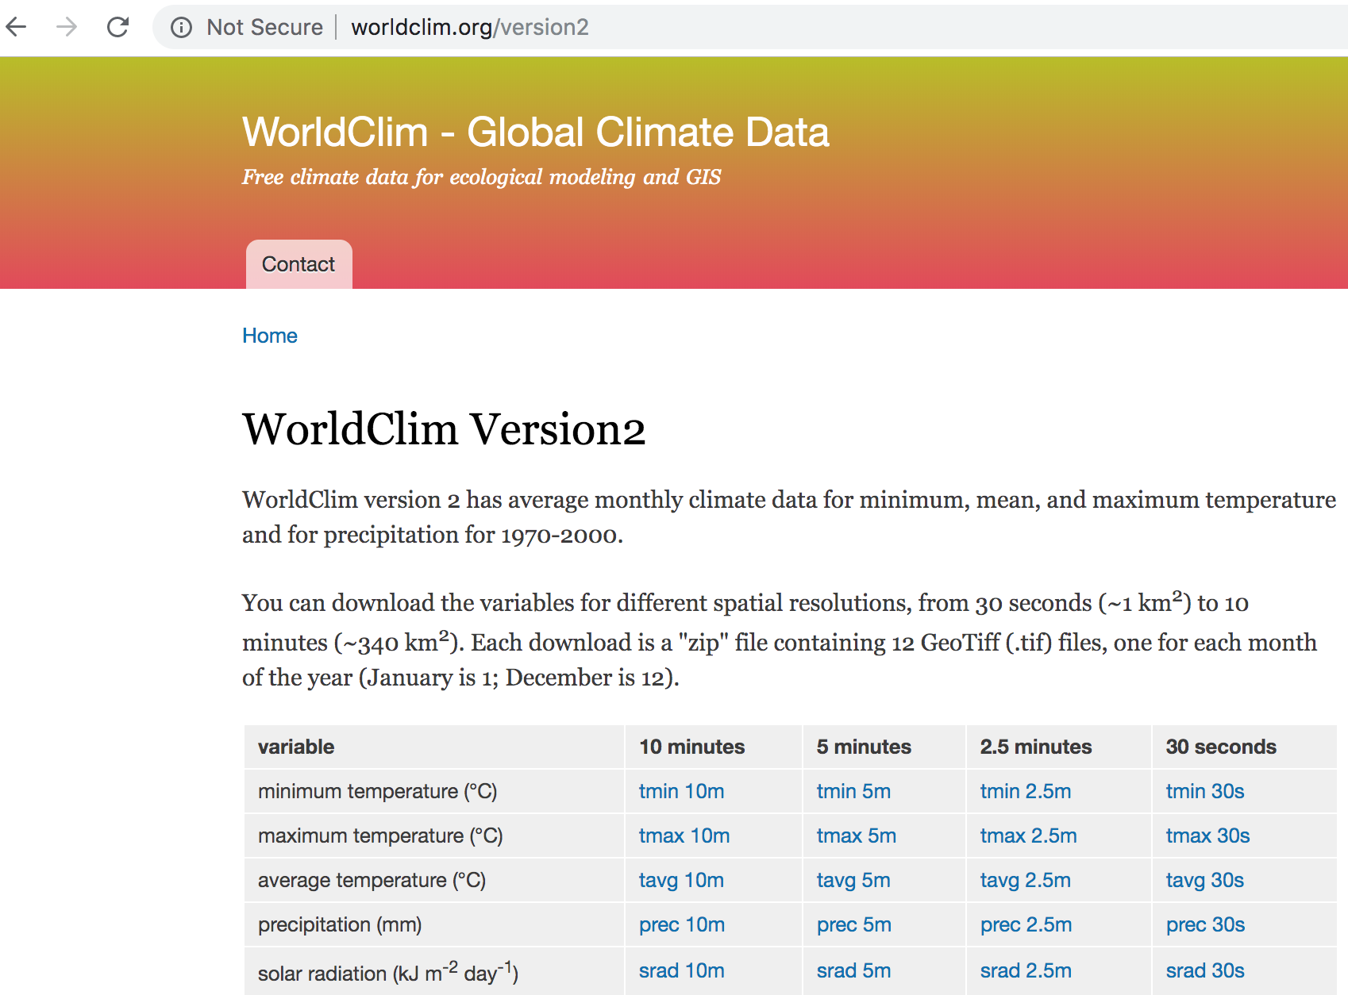
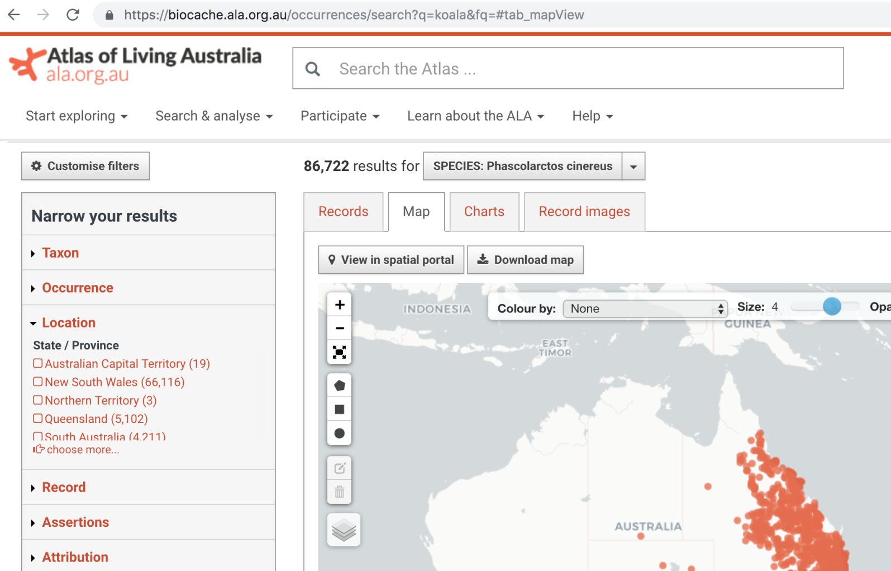
Online data
Notes:
Just to give an idea that there is a LOT of data

